Slide 1
ESC101: Fundamentals of Computing
Wrapping up, and future directions
Nisheeth

Slide 2
No More Prutor after a few days
Prutor logins for all of us will be disabled a few days after the grades are declared – will warn you beforehand!
New logins will be created for your friends in A batch
Need to start using other compilers like gcc
Can keep using Clang as well (need to install it though) – gcc is always available on Linux computers
Windows computers need to install a compiler (VS etc)

Slide 3
Linux and Windows
On Linux systems, gcc compiler will always be available
Can install clang too if you own that machine
On Windows, can install gcc via the Cygwin or the MinGW routes
https://sourceforge.net/projects/tdm-gcc/
Can install Clang on Windows too
http://releases.llvm.org/download.html
However, easier to install Visual Studio on Windows
https://visualstudio.microsoft.com/vs/community/

Slide 4
Compilation and Execution
Suppose your C program is in the file test.c
To compile the C program type gcc test.c
It will create an executable file called a.out
Can execute that file by typing ./a.out
If you want to give the executable a nice name, use the following command gcc –o myname test.c
An executable called myname will get created
Can execute that file by typing ./myname

Slide 5
Explore More..
Interpreted languages such as Python (very popular nowadays)
Object-oriented programming (e.g., C++, Java)

Slide 6
Pursue your Interest
If interested in problem solving – take up competitive programming
https://www.hackerrank.com/
https://leetcode.com/
https://www.codechef.com/
https://www.geeksforgeeks.org/
http://codeforces.com/
Many application areas require heavy programming
Fluid dynamics (AE, CHE), Particle accelerators (PHY), Data Analysis (MTH, CSE), Wireless communications (EE), Optimization (IME, ECO, MTH, CSE)
Several applications within CSE
Architecture, Operating Systems, Compilers, Theory, Algorithm Design, Databases, Web Programming, Machine Learning and AI, and many more

Slide 7
Possibilities at CSE@IITK
All department UGs are welcome to contact CSE faculty

Slide 8

Overview of CSE@IITK’s programming
Systems
Operating system
Networks
Software design
Security
Theory
Algorithms
Complexity
Applications
Data mining
Machine learning
Computational science
Game design
Notes:
Lot of fields, programming is only one aspect.

Slide 9
Writing OS code
What does an OS do?
Talk to devices
Controls programs
Manages data access
Manages resource access
Manages network communication
Linux kernel written in C
You can create your own OS by adding kernel modules to pre-existing base OS
Try it on a PC you don’t mind wrecking!

Slide 10
Flavor of OS programming
Sample Linux device driver code
Could compile with kernel code
Safer to work with kernel modules
Basic operations
Device declaration
Device usage

Slide 11
Device declaration
In Linux, devices ID’ed with a major device number and, optionally, a minor device number
Basic hardware I/O operation: content in device buffer (file) is copied to kernel module-directed system buffer (file)
I/O device files can be block or character
Use the function register_chrdev to register a new device
Requires device number, name and a file_operations data structure as parameters

Slide 12
File operations
struct file_operations {
struct module *owner;
loff_t (*llseek) (struct file *, loff_t, int);
ssize_t (*read) (struct file *, char *, size_t, loff_t *);
ssize_t (*write) (struct file *, const char *, size_t, loff_t *);
int (*readdir) (struct file *, void *, filldir_t);
unsigned int (*poll) (struct file *, struct poll_table_struct *);
int (*ioctl) (struct inode *, struct file *, unsigned int, unsigned long);
int (*mmap) (struct file *, struct vm_area_struct *);
int (*open) (struct inode *, struct file *);
int (*flush) (struct file *);
int (*release) (struct inode *, struct file *);
int (*fsync) (struct file *, struct dentry *, int datasync);
int (*fasync) (int, struct file *, int);
int (*lock) (struct file *, int, struct file_lock *);
ssize_t (*readv) (struct file *, const struct iovec *, unsigned long,
loff_t *);
ssize_t (*writev) (struct file *, const struct iovec *, unsigned long,
loff_t *);
};

Slide 13
Device usage
Use a function that copies entries into the device buffer to the kernel
long copy_to_user( void __user *to, const void * from, unsigned long n );
You get a working driver!

Slide 14
Network communication
We just saw device to system communication
Network to system communication?
Network identity is dynamic
Channel capacity is dynamic
But essential idea remains the same
Declare identity of network source
Copy contents from source to local buffer

Slide 15
Security
Reading from and writing to unknown parties is risky
Particularly when information is financial
Have to secure access
This is a job for cryptography
Basic idea is to encrypt message such that only entities that should be receiving the information can decrypt

Slide 16
System design
Designing systems that can communicate internally and externally
Securely
Efficiently
Scalably
In general: you want to know C (Unix), C++ (Windows)

Slide 17
Web service design
Can get started with AWS free
Have to choose basic tech stack
Python
Java
JavaScript
Have to design for two types of database access
Structured (RDBMS)
Real-time (MongoDB)
Front-end
C++, C# etc.
JS
PhoneGap (HTML)
In general: you want to know JavaScript (personal opinion)

Slide 18
Theory
Algorithm design tries to address issues of efficiency and scale
We’ve seen some examples, such as in merge-sort and quick-sort
Vast area, with massive multiplier influence
If you like discrete math, you may like computational theory
CS201,202,203 offer math background for this

Slide 19
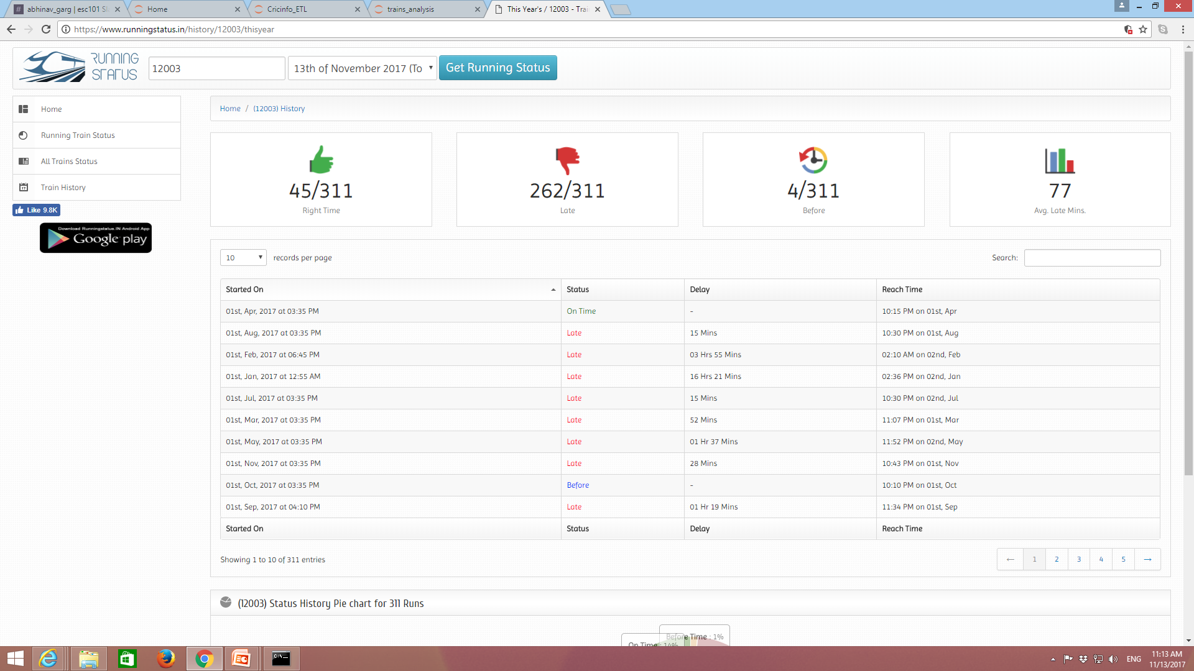
Data analysis

Slide 20
Working with data
When we know what we’re looking for
Data analysis
Targeted, high quality data
Domain knowledge matters
When we don’t know what we’re looking for
Data mining
Exploratory, data quality unknown
Algorithmic prowess and skill matters

Slide 21
Machine learning
Subset of data mining
Basic idea is to
Get algorithms to find things that look like other things we show them
Get algorithms to categorize things automatically
Lots of very well-developed code libraries pre-exist
Weka
Matlab ML toolbox
Scikit-learn library in python
You want to know python

Slide 22
Computational science
Mathematical analysis breaks down as soon as the number of elements you’re studying grows
Physicists, chemists, biologists, and neuroscientists are all are trying to build realistic simulations of scientific phenomena to study them counterfactually
Designers, social scientists, artists are doing the same for their creations
“What I can’t create, I don’t understand” - Feynman

Slide 23
Possibilities are wide open
Have fun writing code the rest of your time here
Don’t hesitate to talk to any of the CSE faculty
It would help if you know what you want to talk about
Be bold in coming up with ideas
Worst case scenario: it won’t work
Your next idea will be a better one, guaranteed

Slide 24



ESC101 is just a beginning…
Have fun computing and
thinking programmatically..
Mr. C signing off.. Thanks!

